Slide 1
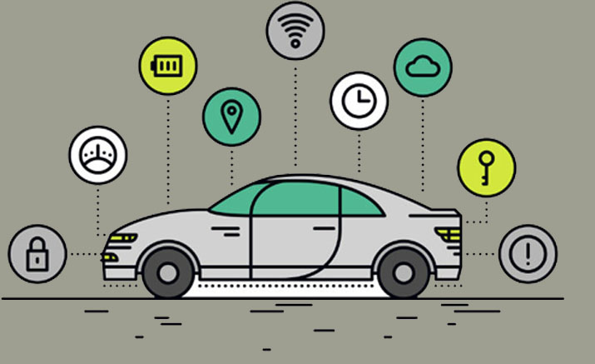
Smart Car Parking System
COSC 43206-Research Project
PS/2014/002
P.M.D.S Amarasooriya

Slide 2
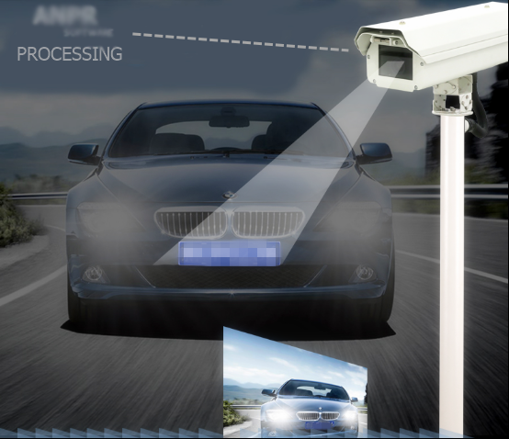
Introduction
World population is increasing.
Increasing the number of vehicles being used.
Smart car parking system will assist users to solve the issues.
Finding a parking space
To minimize the time spent in searching for the nearest available car parking area.
Using sensors or another method that detect the presence or absence of a vehicle.
Signs direct incoming drivers to available locations.
Notes:
1. World population is increasing day by day.
2. Because of this reason rapidly increasing the number of vehicles being used.

Slide 3
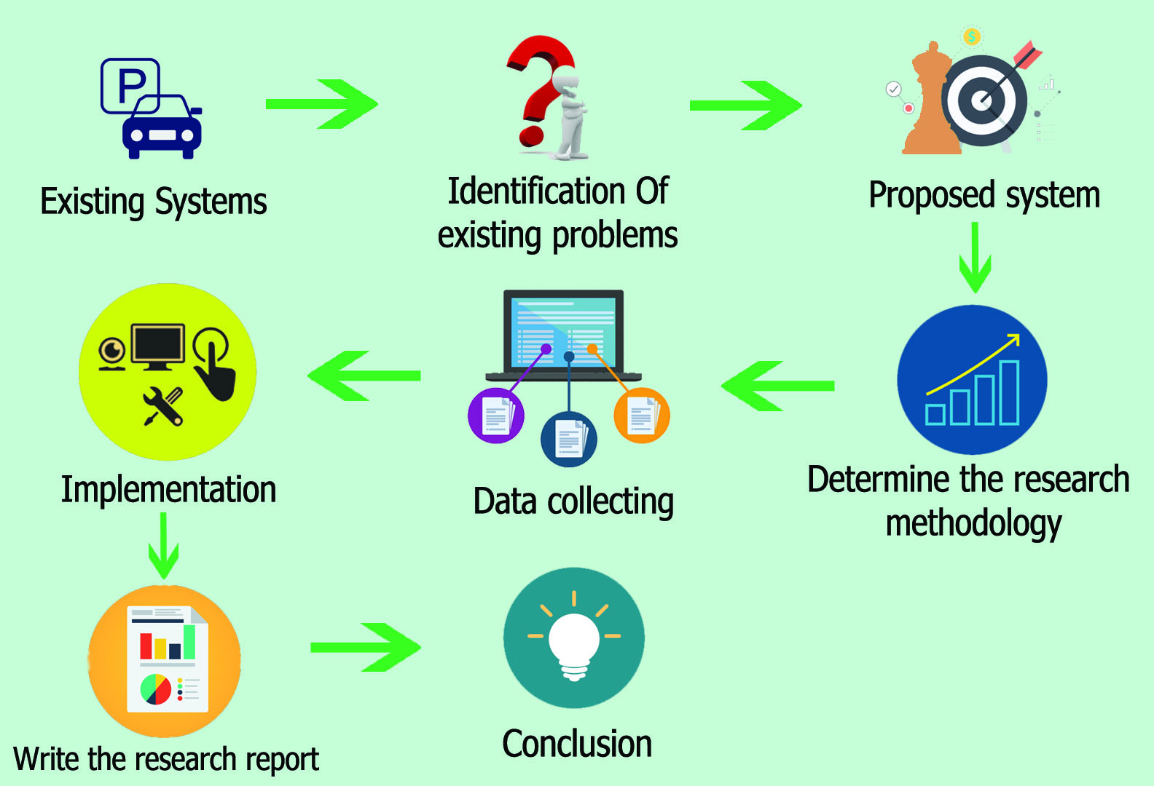
Methodology

Slide 4
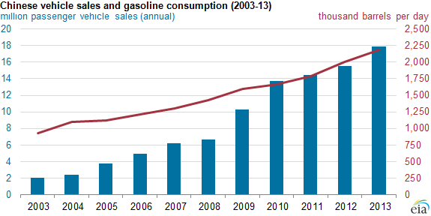
Problems Of Car Parking System
Increasing number of vehicles leads to high demand for parking space.
Difficulty in finding a space to park the vehicle.
Wasting time for searching empty slot.
Nowadays, parking areas are becoming larger, because of that driver cannot monitor the parked vehicle.
More fuel consumption while driving around the parking lots leads to high emission of Carbon dioxide.
Potential accidents caused by abundance of moving vehicles.
Increase in stress level of drivers.
Notes:
Below graph show usage of vehicle is increasing years by years.

Slide 5
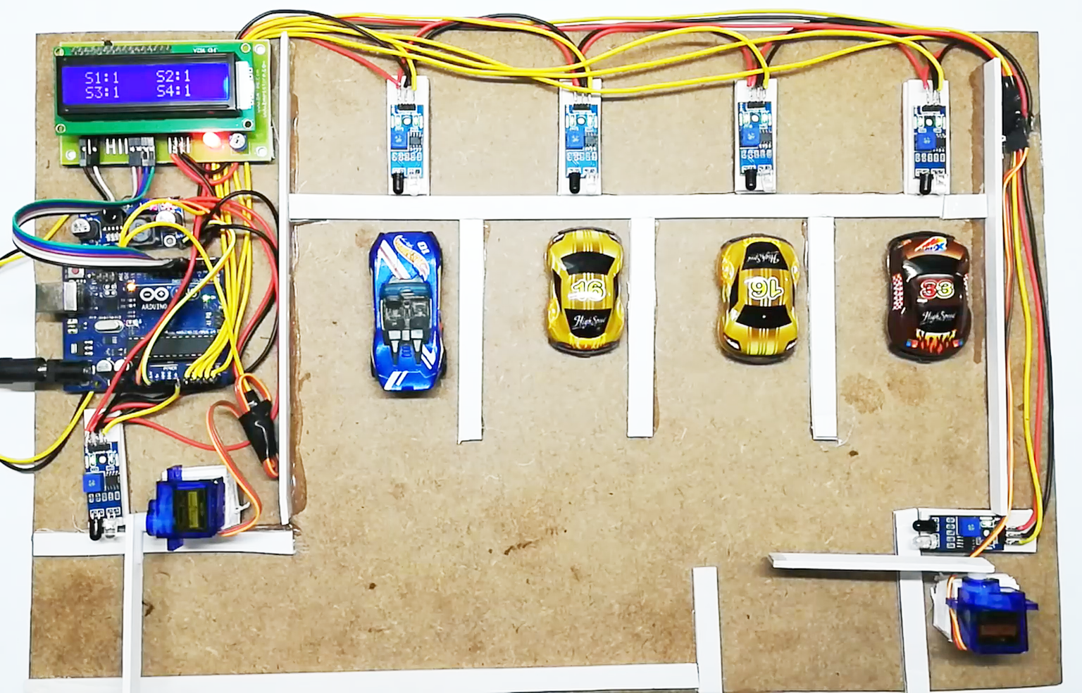
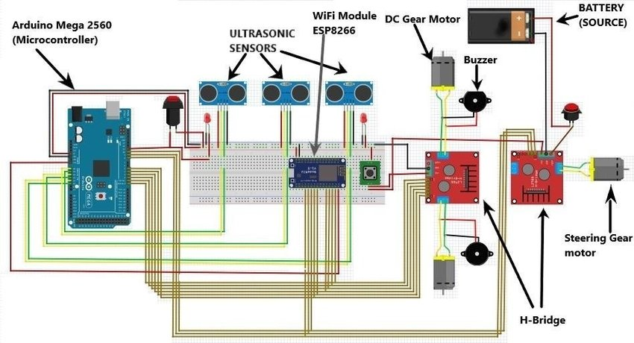
Existing System
Most of car parking systems has come up with IOT mechanism.
It contains an Arduino microcontroller as the main processing unit and it gets inputs from the IR sensors which guide the user to know the empty parking space.
In this case each slot must have sensors.
It is difficult to handle very large parking area.
Notes:
It’s take high cost fix IR sensors for every slots.

Slide 6
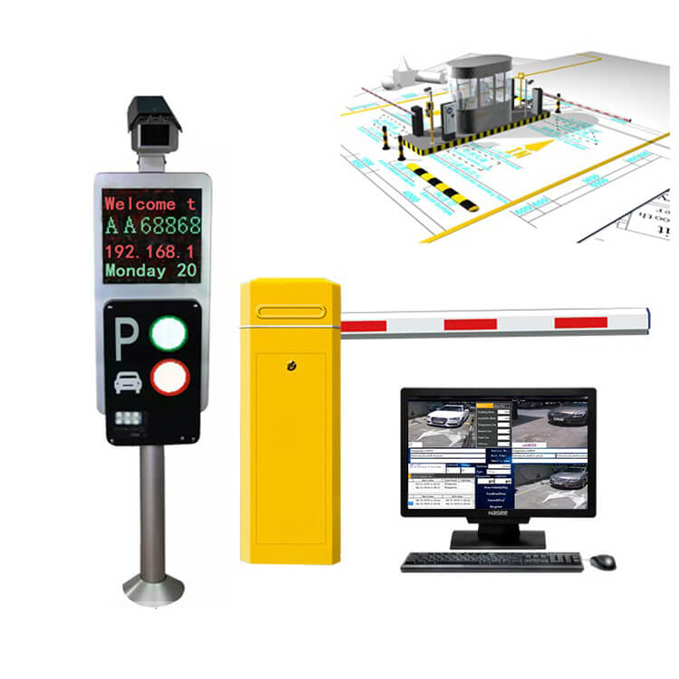
RFID Smart Parking System is another way.
The RFID reader smart parking system is installed near the barrier gate.
RFID card is fixed on vehicle.
It could be used to charge the amount.
The problem in this system is driver doesn't know available parking slot before reach the parking area.
Notes:
When a vehicle come to parking area, rfid reader detect all information about the driver.

Slide 7
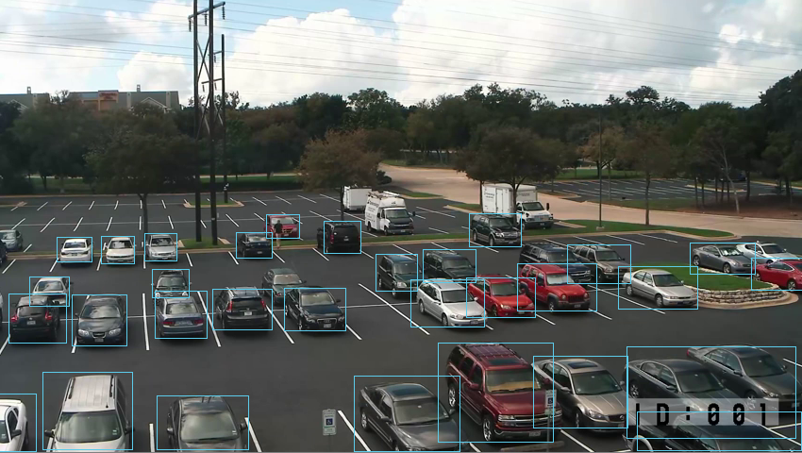
Proposed System
This presents a smart parking system which operates using image processing.
Cctv camera footages have used to detect the vacant parking spaces.
YOLO object detection algorithm has used to detect the vehicles.
YOLOv3 is one of the most popular real-time object detectors in Computer Vision.
Notes:
The published model of yolov3 recognizes 80 different objects in images and videos. I consider the car class only.

Slide 8
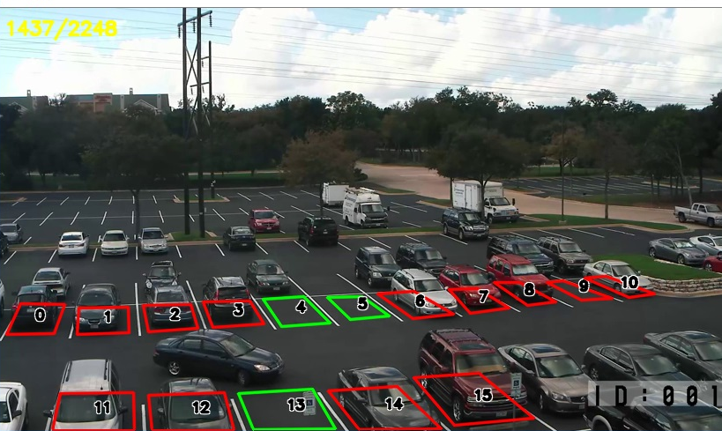
Current Process
Gave an unique id for each parking slot.
Plot the bounding box in every slot.
Used OpenCv machine learning software library for drawing the bounding box and to display the unique id.

Slide 9
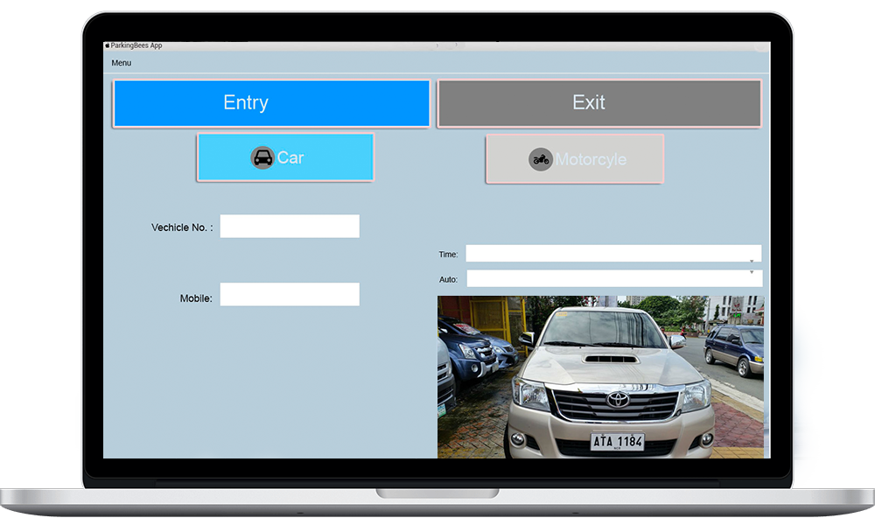
If there is a vehicle inside the given bounding box, it marks as red.Otherwise green.
For drawing the bounding box consider the (X,Y) coordinate of each frame.
After analyzing the real time video, display the available free and nearest slot.

Slide 10
Conclusions
Allows to detect parking place using video processing.
Help the drivers to find the empty spot in parking area more easily with less time.
Enables to develop fully integrated multimodal intelligent transportation system with high security and efficiency.

Slide 11
References
OpenCV documentation :https://docs.opencv.org/master/d9/df8/tutorial_root.html
yolov3 custom object detection :https://www.learnopencv.com/training-yolov3-deep-learning-based-custom-object-detector/
OpenCv-python:https://opencv-python-tutroals.readthedocs.io/en/latest/py_tutorials/py_setup/py_intro/py_intro.html

Slide 12
Thank You!

